Slide 1
Hedonic Pricing Model For Airbnb
Andrew McGraw, Maryam Tabatabaei, Cade Schkerke, Qixuan Wang, Karly Ringstad, Nathanuel Martin

Slide 2
Goals
Which neighborhood is least/most expensive in LA?
How is price impacted by reviews (NLP), room types, host, and neighborhood?
How do offered amenities influence price?
Create multiple dashboards filtered by neighborhood, room type, price, host experience, and number of reviews from 2020 Airbnb data.

Slide 3
Data Exploration
We used both supervised and unsupervised machine learning models to explore any connections and relationships between variables.
Examples include:
Price
Neighborhood
Amenities
Room-Type
Guest Accommodation
Old Source: https://www.kaggle.com/oindrilasen/la-airbnb-listings
New Source: http://insideairbnb.com/get-the-data.html

Slide 4



Front End
HTML
- Utilizes leaflet and Bootstrap libraries
JavaScript
- We used a GeoJSON file to design a leaflet map
CSS
- Format HTML elements
- Bootstrap CSS

Slide 5
Back End
Python Query
- Transformation : Merge datasets
- Load into PostgreSQL database
-Make Visuals
ERD Database
- Seven Tables
- Use AWS to upload our data
Python Flask
- app.py
- Pulls template and other files together to render data

Slide 6
Naïve Bayes Results
Used Bucketizer to categorize our reviews by score
Used Tokenizer for token creation
Created a UDF from lang_detect to identify English reviews
Created stop words from these reviews
Created Hashed dataframe
Created IDF
Vectorized and trained NB model to predict review scores

Slide 7
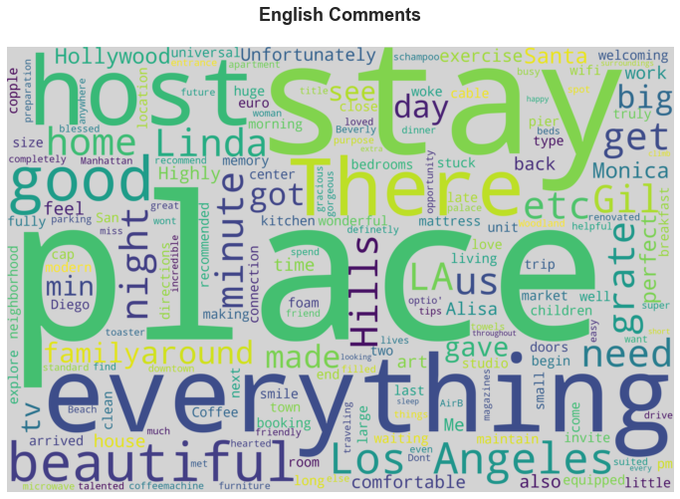
Word Cloud Maps
Most frequent English words in the review comments.

Slide 8
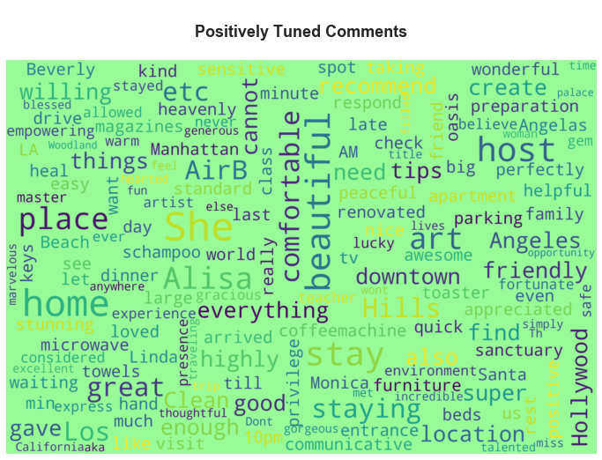
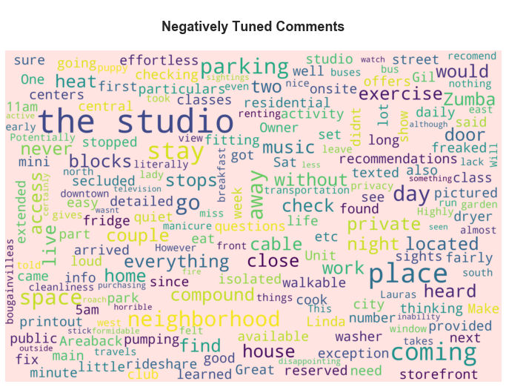
Topic Modeling: Positive & Negative tuned Comments

Slide 9
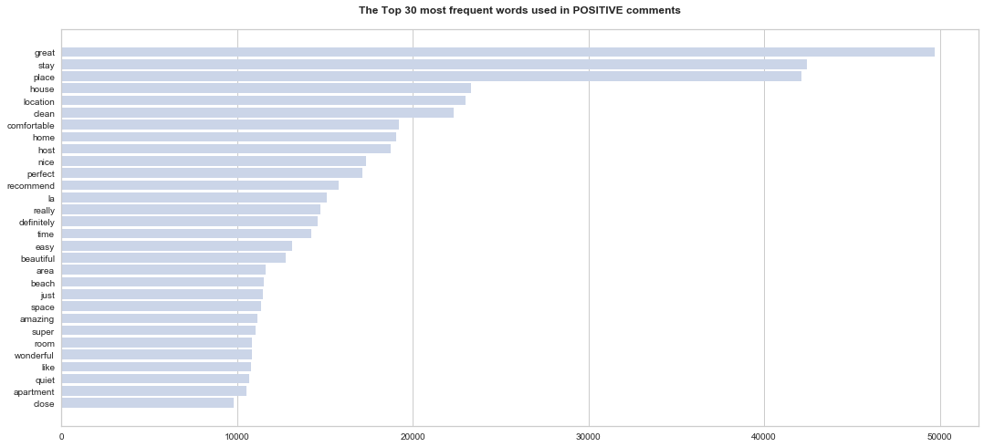
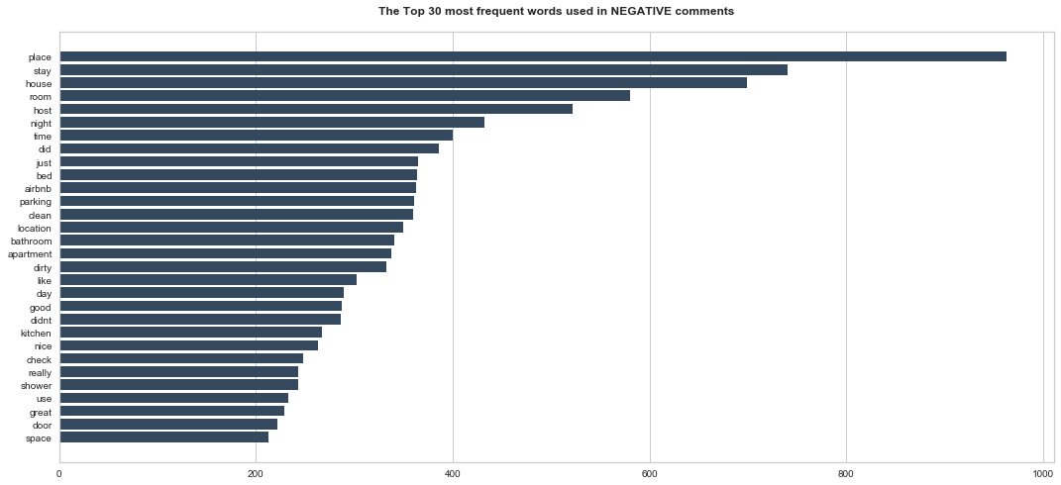

Slide 10
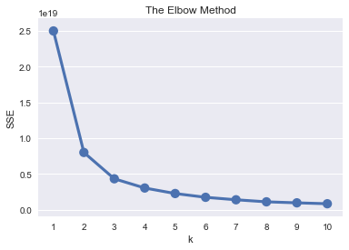
K-Means Clustering
Find cluster centers that minimize the sum of distances between data samples and their associated cluster centers.
kmeans = KMeans(n_clusters=3, random_state=1)
kmeans.fit(pc_data)
predicted_clusters = kmeans.predict(pc_data)
kmeans.score(pc_data) -4.308237925188447e+18

Slide 11
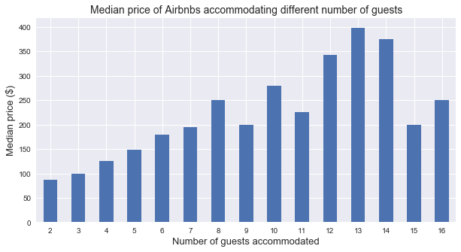
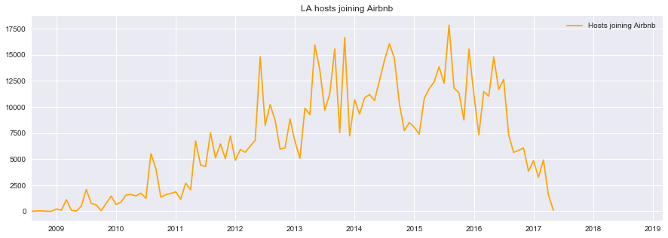
The relationship between the number of host for Airbnb throughout the years.

Slide 12
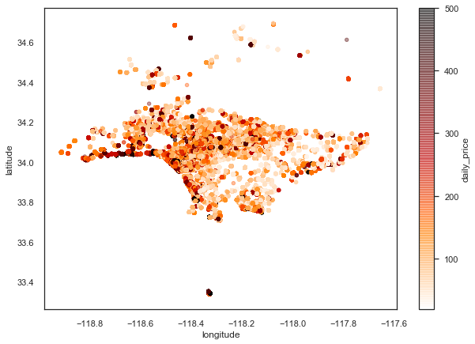
Price Differences by Location

Slide 13
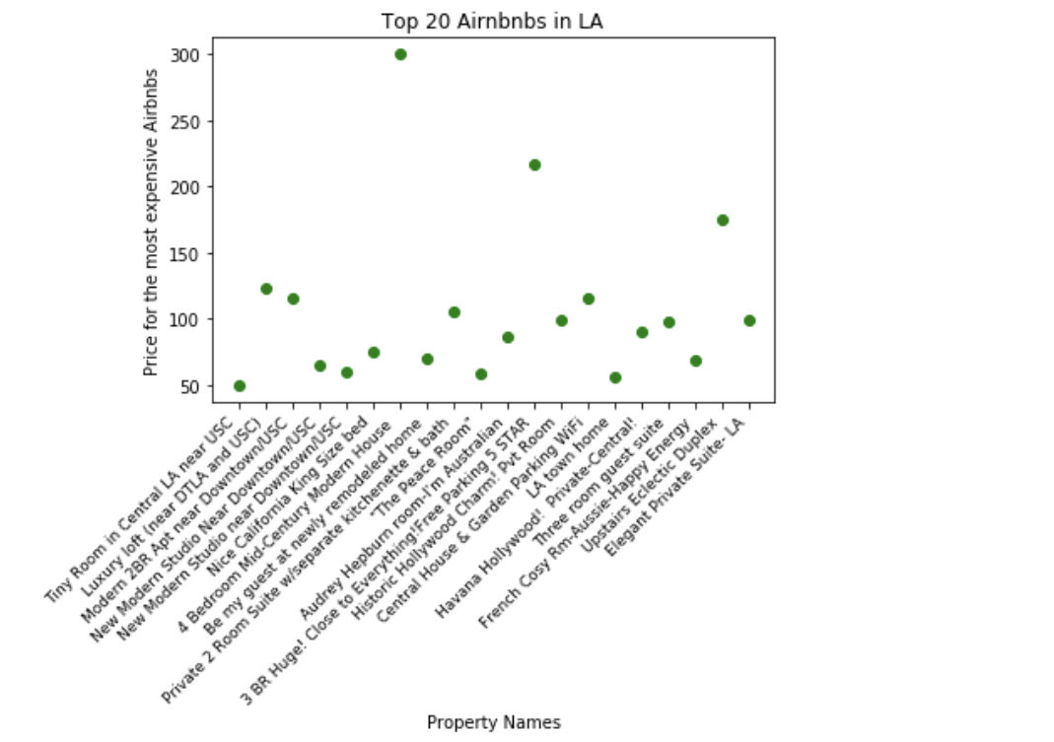
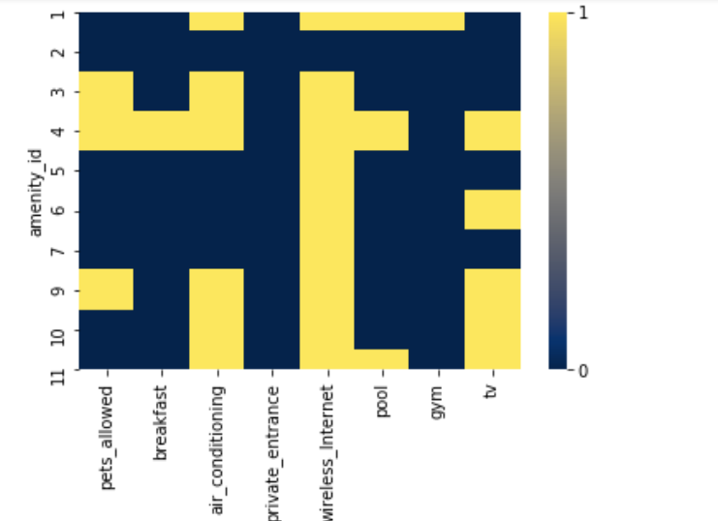
Top 10 property amenities by features
Top 20 properties by the price

Slide 14
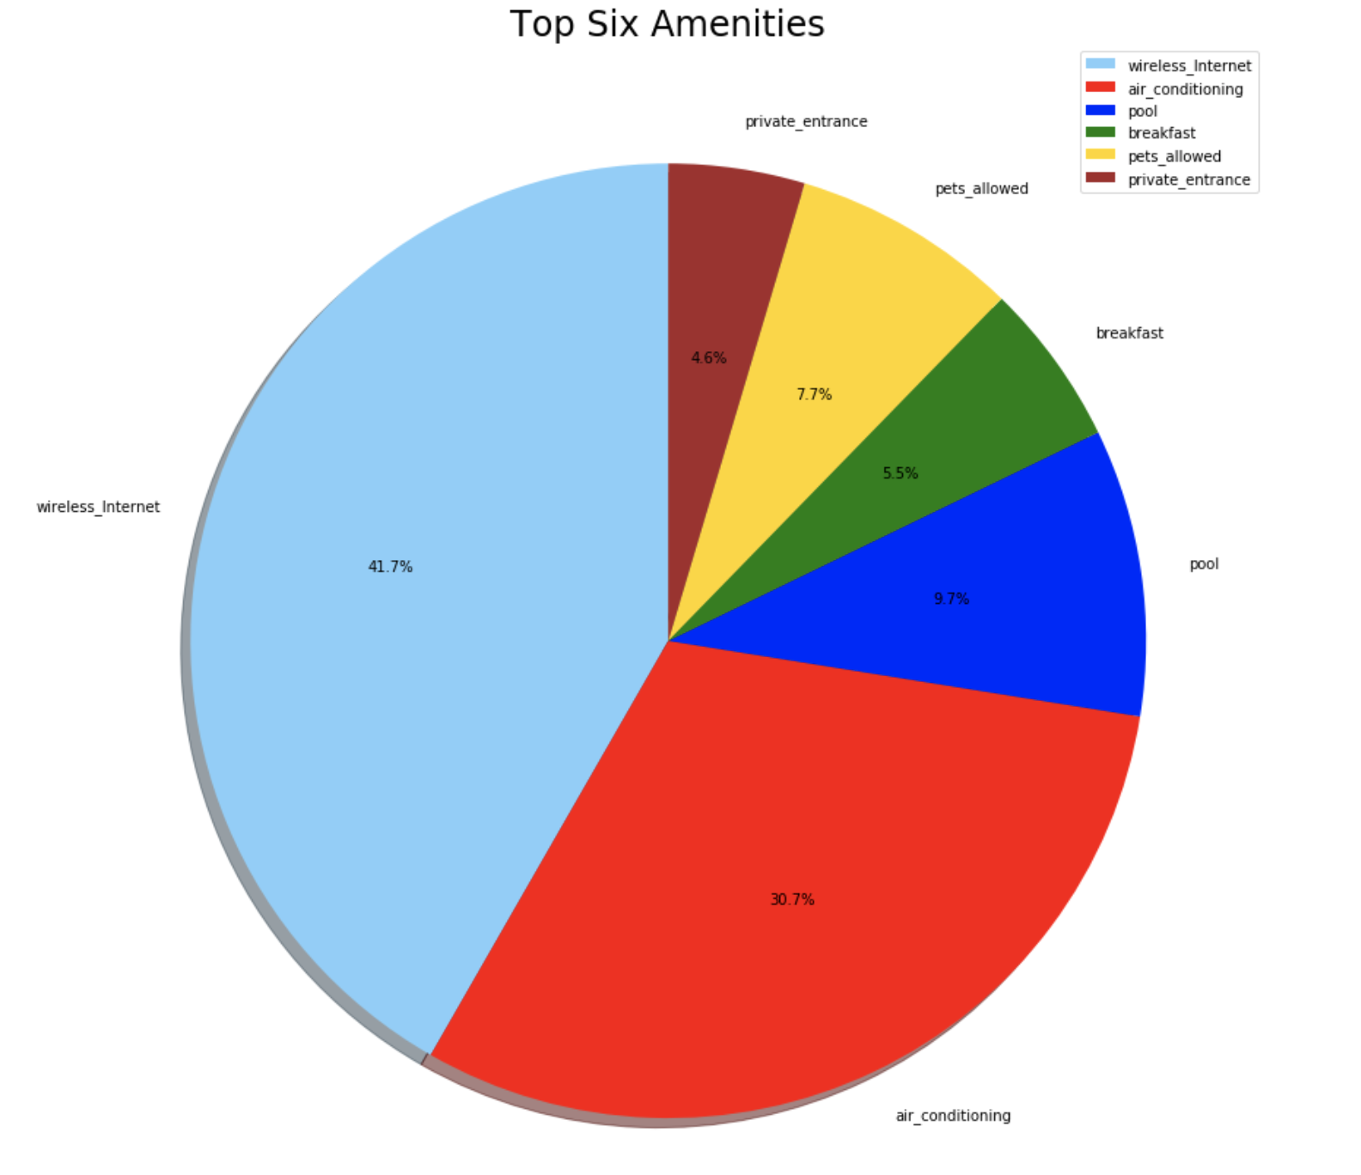
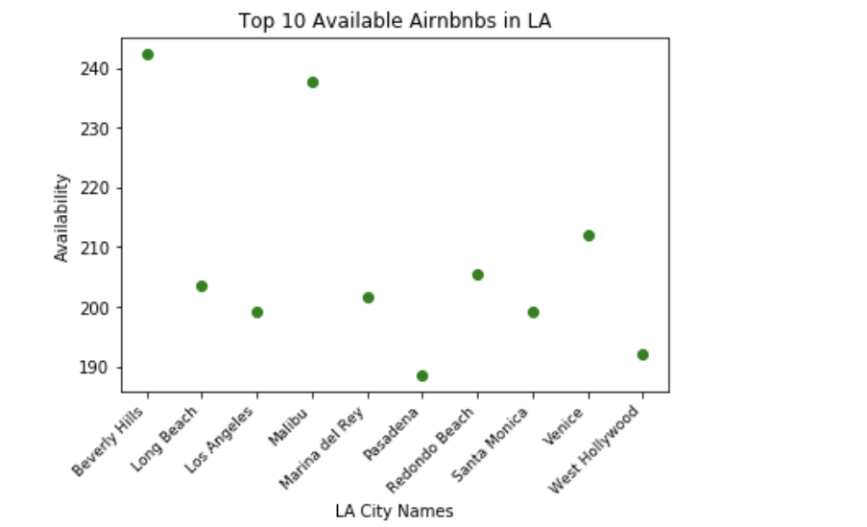

Slide 15
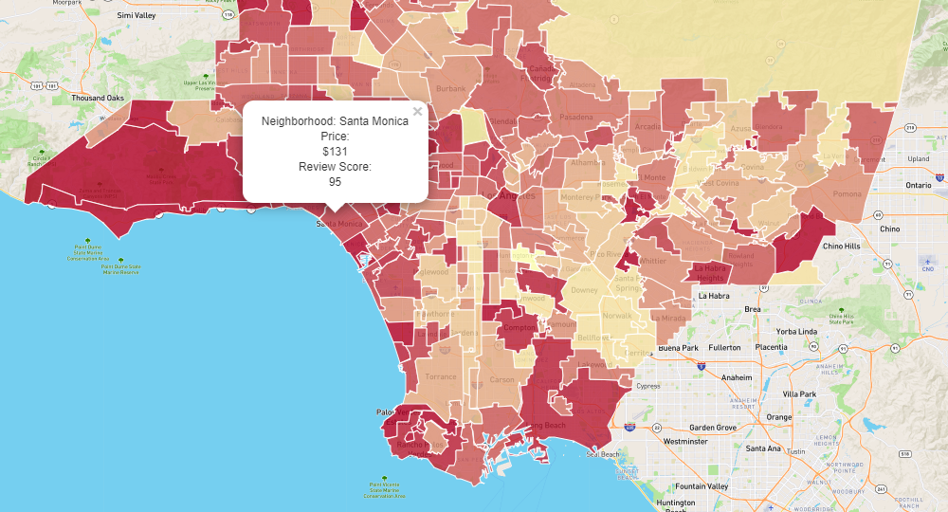
Choropleth Leaflet Map
This map shows each neighborhood in LA that has Airbnb’s.
Combination of GeoJSON and Flask

Slide 16
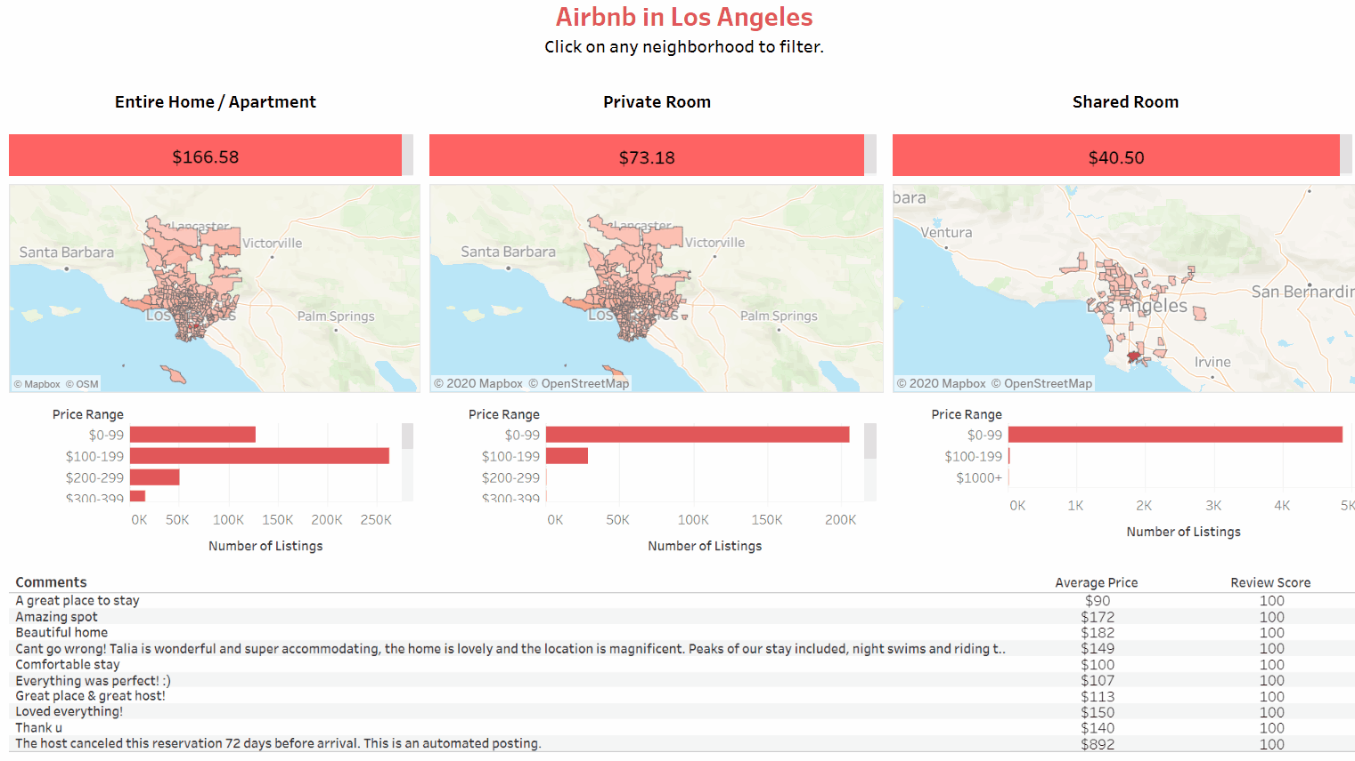
Room Type Dashboard

Slide 17
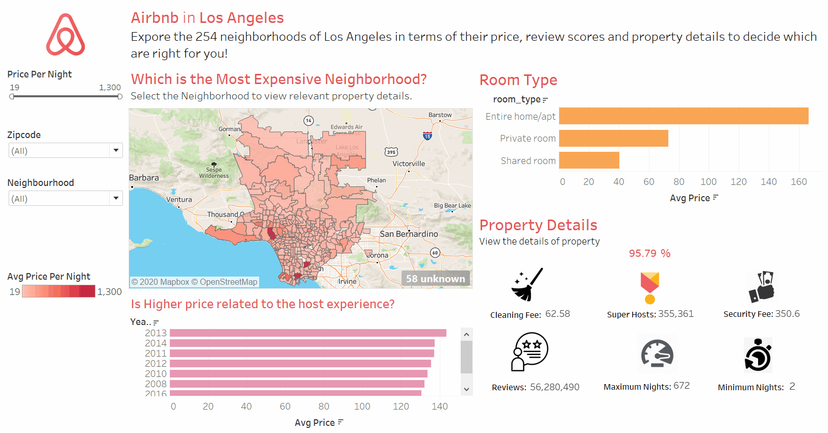
LA Dashboard

Slide 18
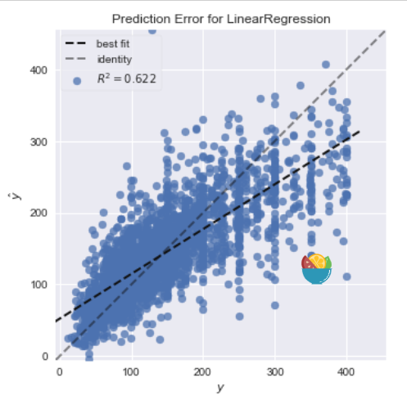
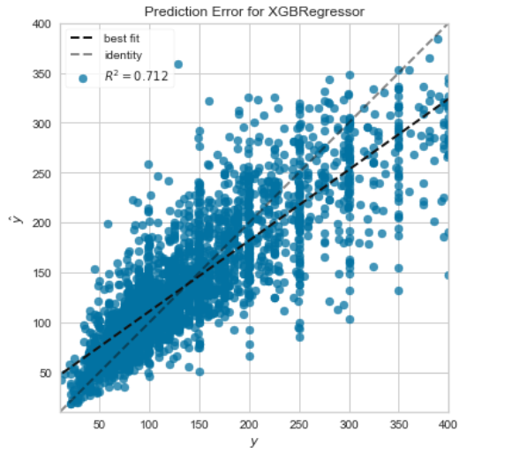
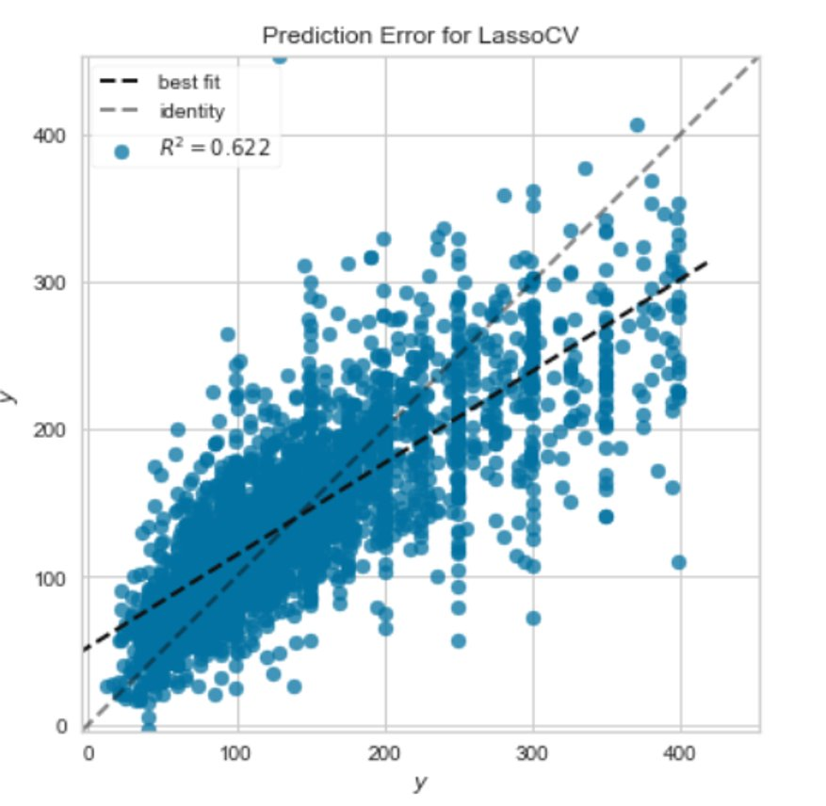
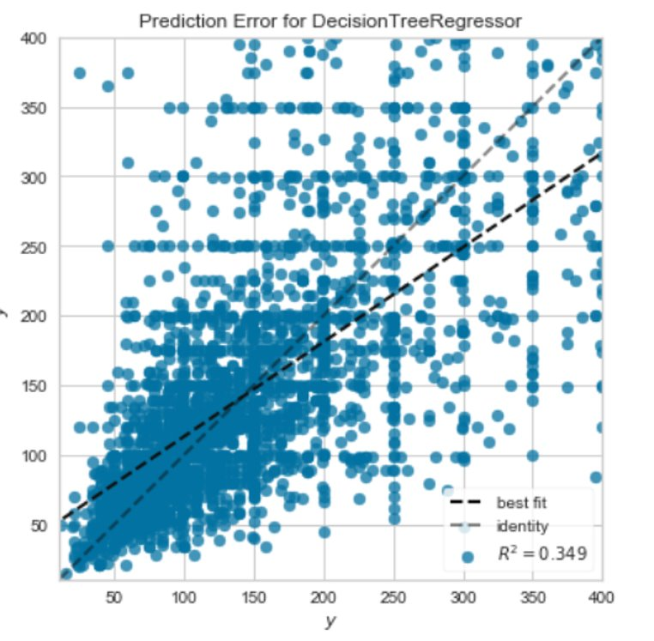
Price Models
Best Model: XGBoost

Slide 19
Conclusion
Based on predictions from our models we concluded:
The most expensive neighborhoods to rent in are Bel-Air and Harbor City at $1300/night, and the least expensive is Huntington Park at $19/night.
Desirable neighborhoods have higher prices, the longer a person is registered as a host, the higher the price.
Amenities do influence price (slightly), with indoor fireplaces influencing the most, followed by hot tubs.
Heroku Application
https://airbnb-machine-learning.herokuapp.com/

Slide 20

Questions

